Slide 1

E-Commerce Management System
Group No: 20

Slide 2

Introduction
UniversalMart's E-Commerce Management System:
UniversalMart revolutionizes online shopping with seamless order placement, detailed inventory management, and advanced global delivery logistics.
Transactional Coordination: Our database accelerates transactions for improved efficiency.
Inventory Management: We ensure detailed inventory control for optimal product availability.
Order Fulfillment: Our streamlined process guarantees quick delivery to meet customer needs.
Logistics Optimization: Our tools advance both international and local deliveries for better service.

Slide 3
Design Decision
For Order Management: We've created Orders, Order Lines, and Reviews entities to efficiently track each order from start to finish, ensuring timely processing and customer satisfaction.
For Inventory Control: Our system's Item Catalog and Classification entities ensure accurate tracking of inventory and product details for effective stock management and correct customer representation.
For Delivery Coordination: Our logistics entity covers global and local shipping, offering real-time delivery tracking to optimize routes and schedules for swift customer service.
For System Integration: The design ensures a cohesive database that automates and streamlines the e-commerce workflow, from order entry to delivery.

Slide 4
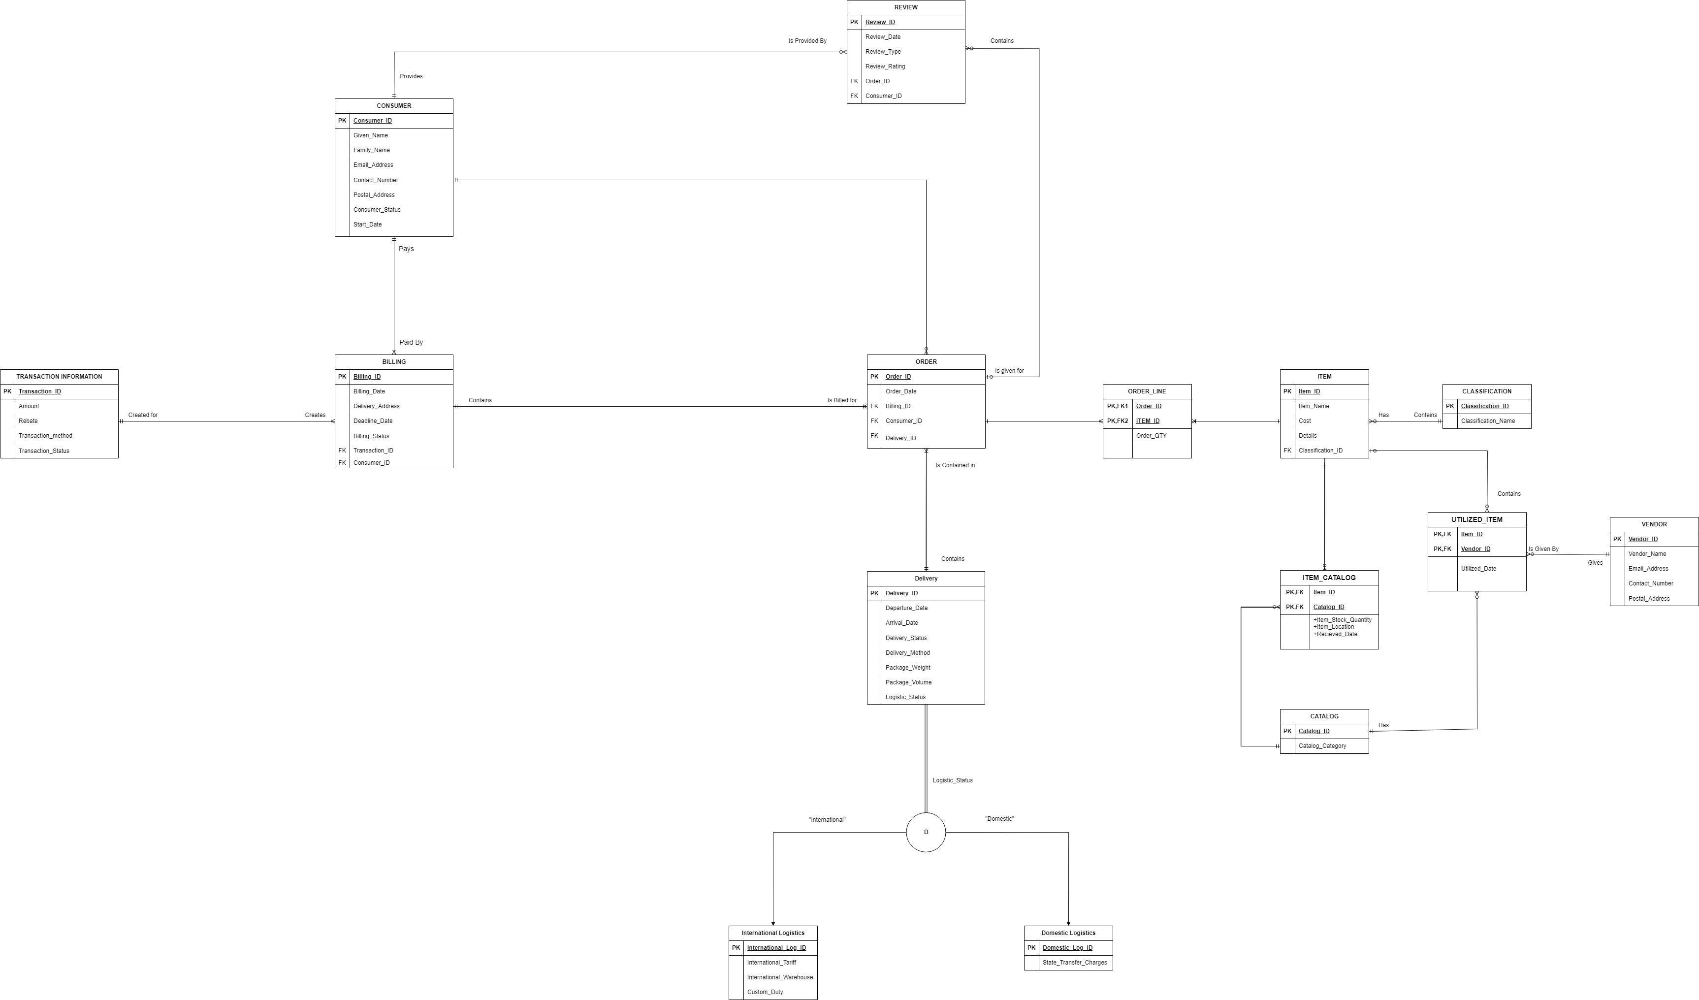
ERD

Slide 5
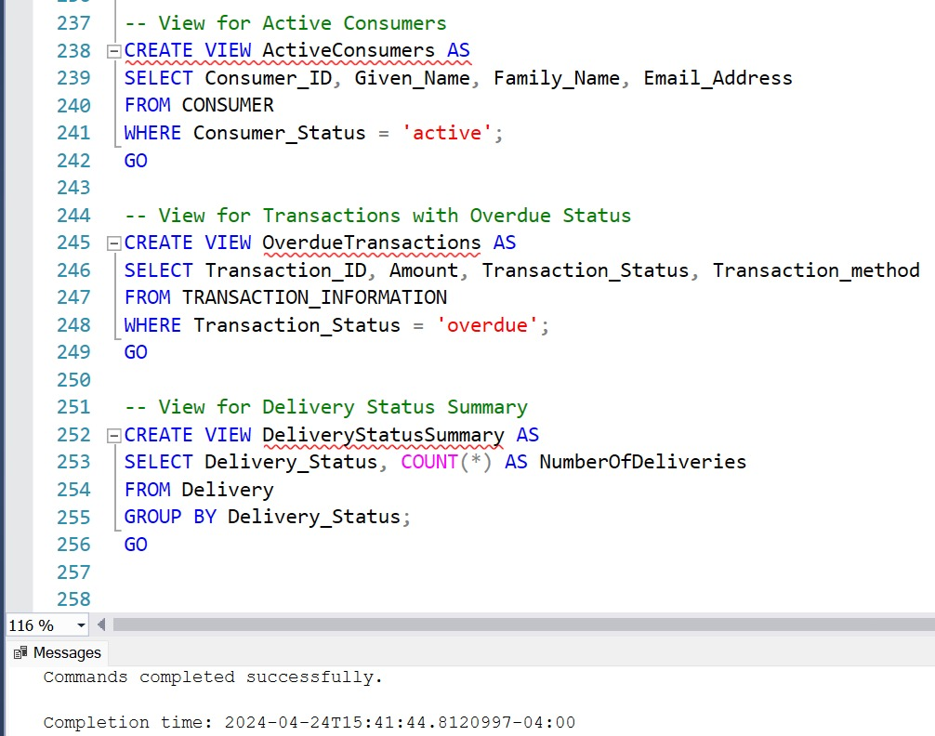
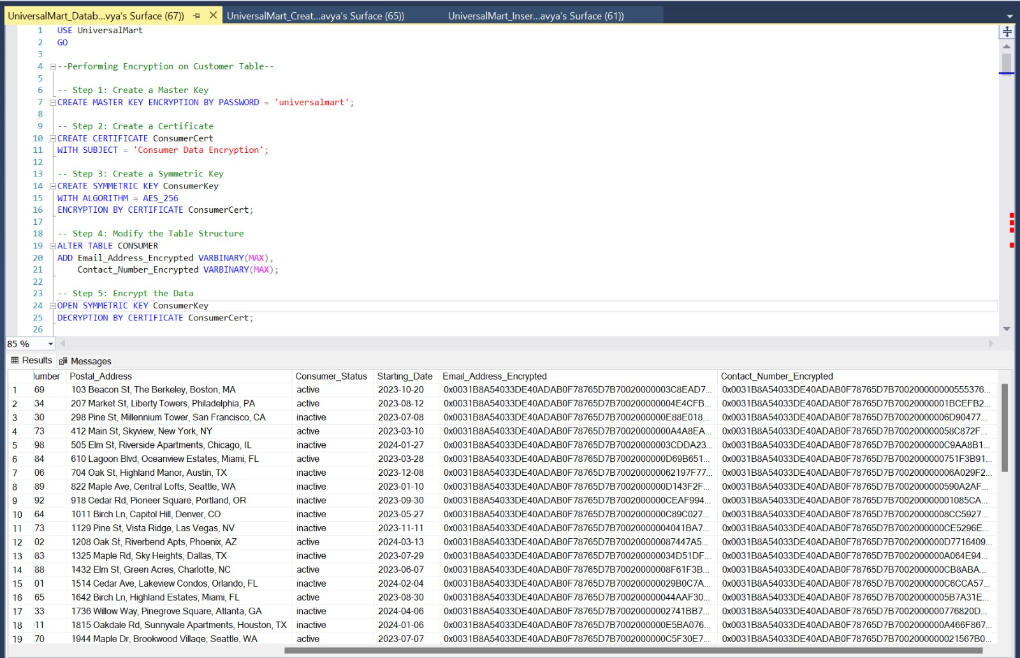
Views
Encryption of column

Slide 6
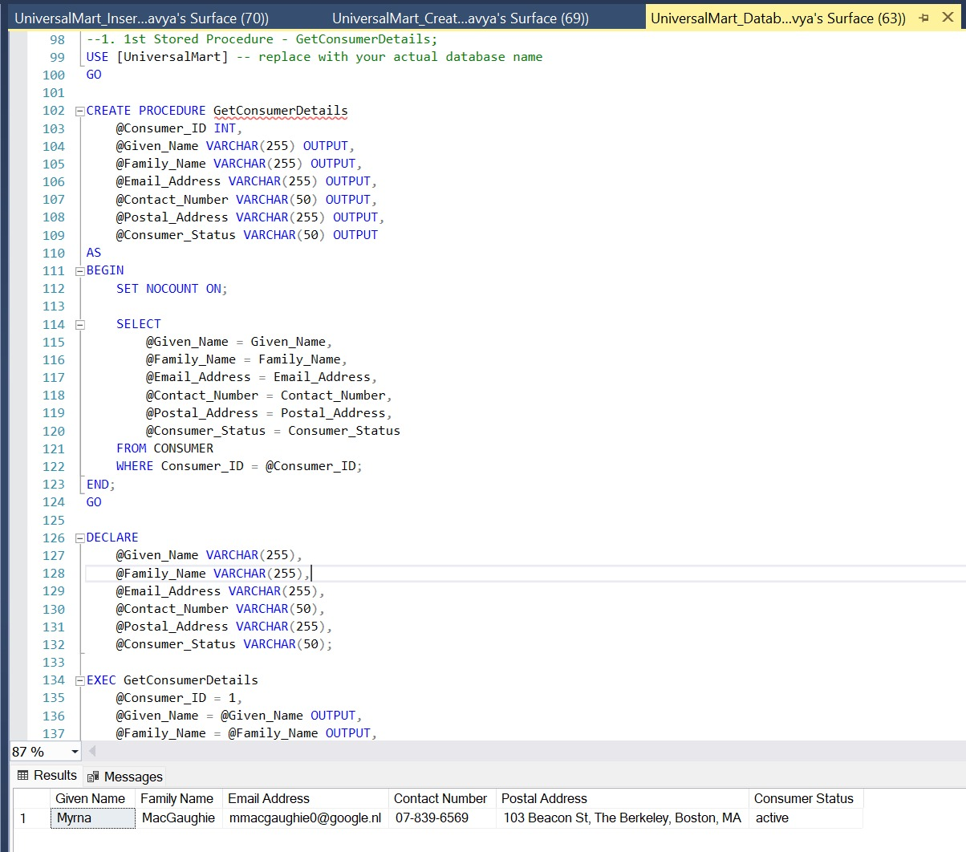
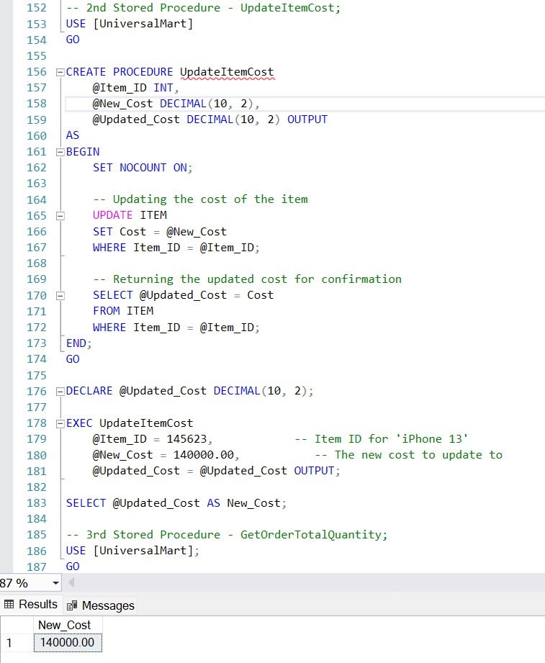
Stored Procedures

Slide 7
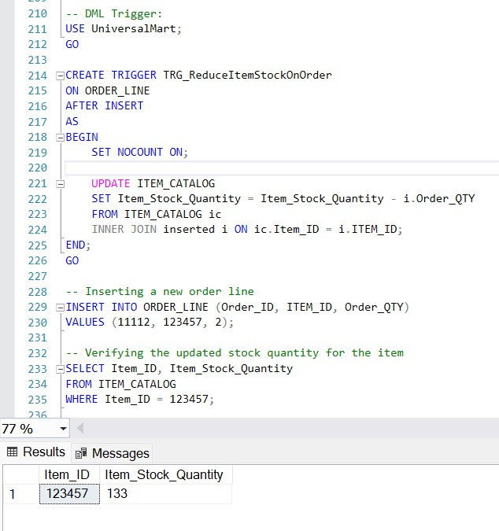
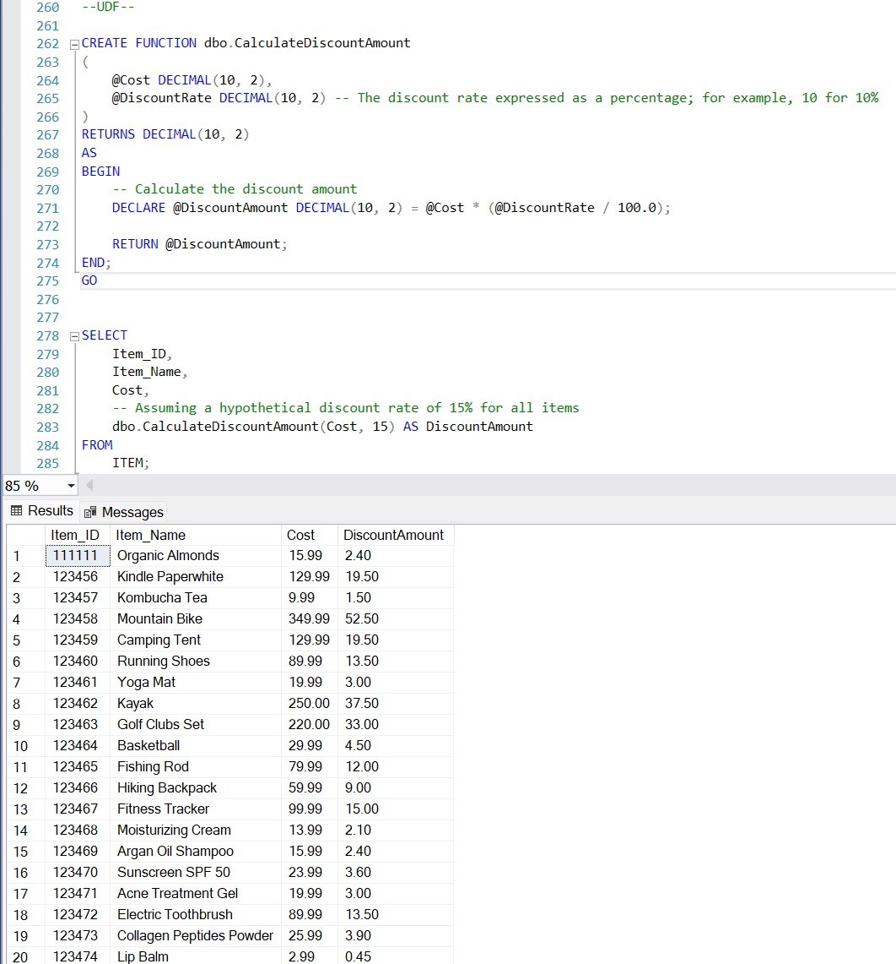
Trigger
User Defined Function

Slide 8
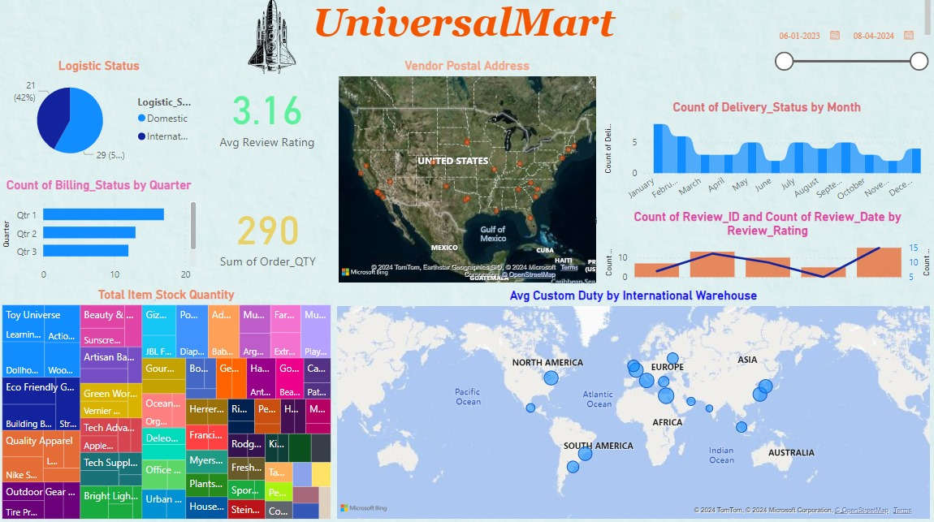
Dashboard

Slide 9
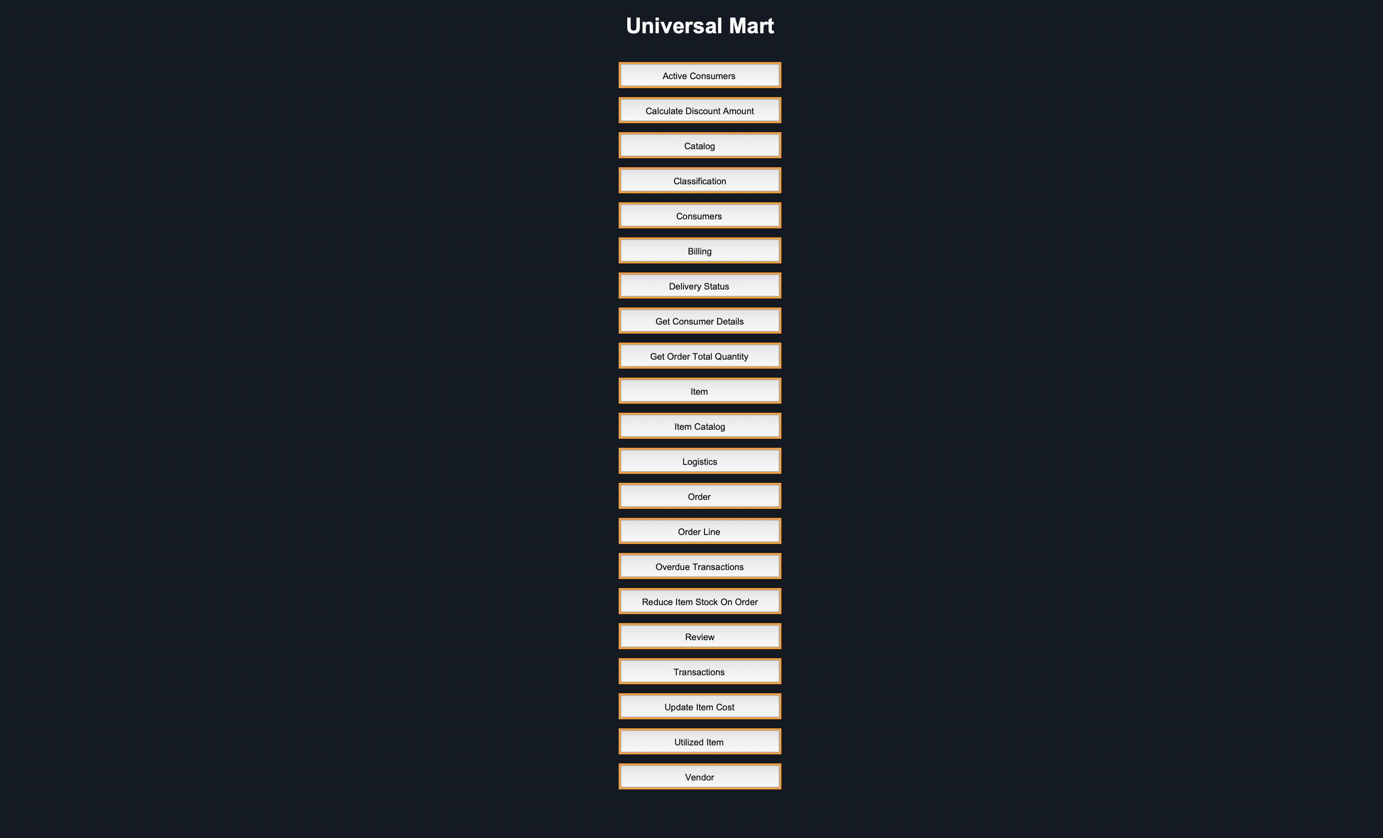
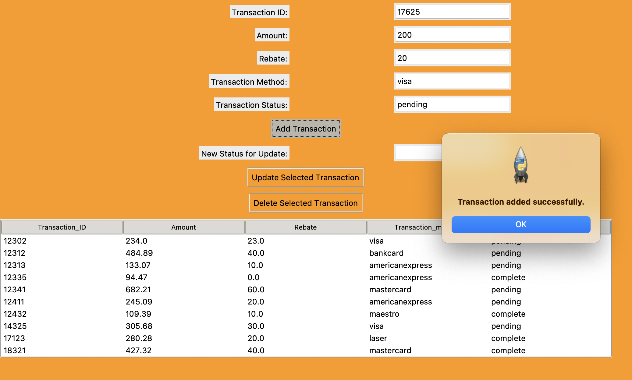
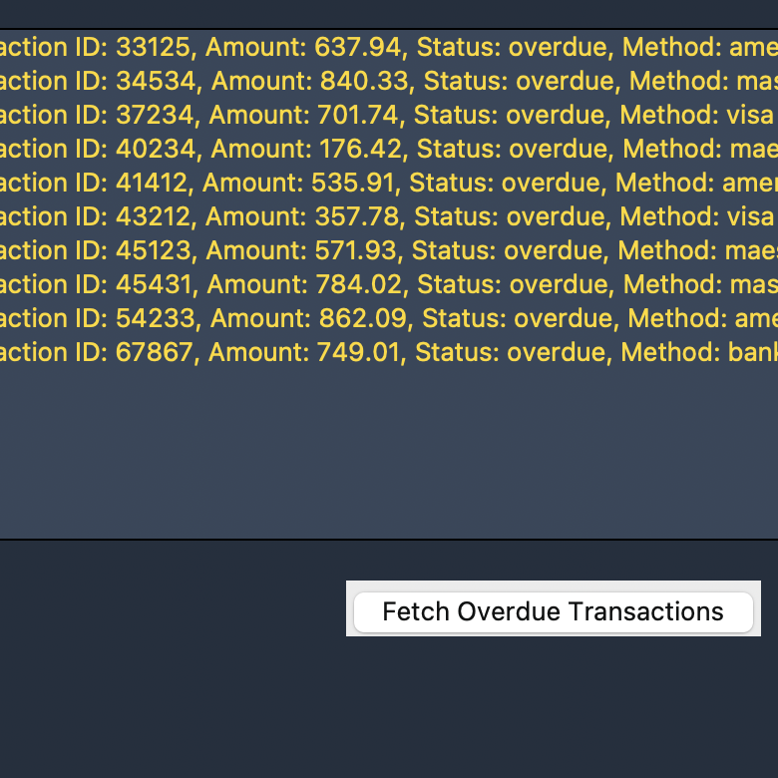
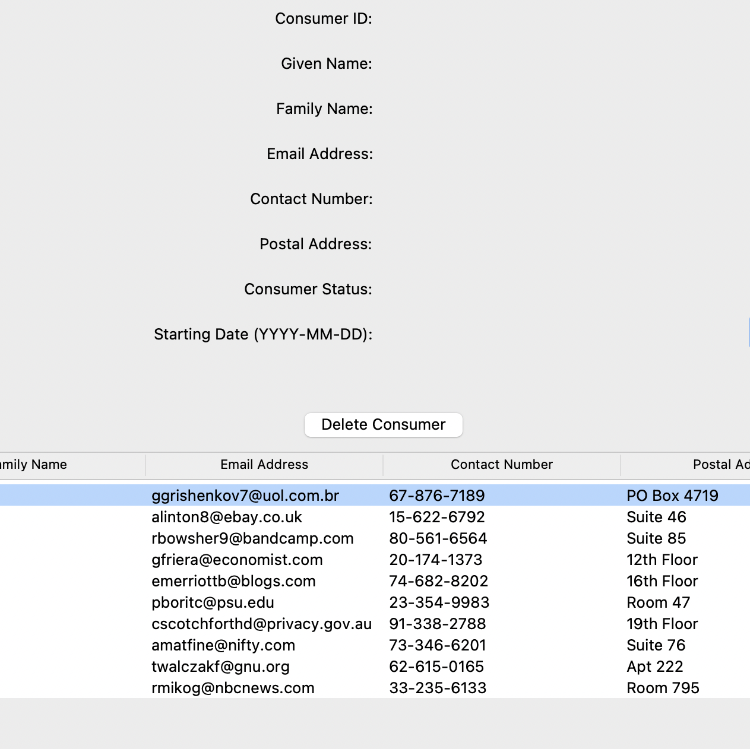
GUI
We've created an effective graphical user interface with Python, enabling us to access information from the tables.

Slide 10

FUTURE PROSPECTS
Customer Loyalty Program: Develop loyalty programs that reward repeat customers, leveraging the order and feedback data to tailor rewards.
2. Mobile and Web Expansion: Expand the e-commerce platform to mobile apps and enhance web interfaces to provide a multi-channel shopping experience.

